Slide 1
ch01:Creating Objects

Slide 2
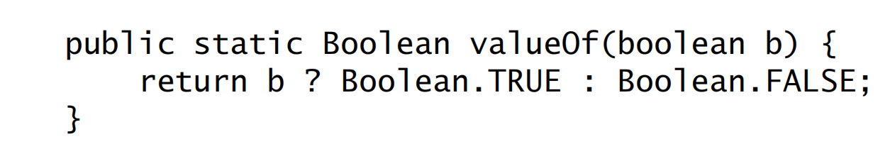
When to Use static method
They can behave similar to constructor and return a new object instead of using a public constructor.eg
This has Both Adavntages and disadvantages

Slide 3
Advantage of static methods
Better naming
For example, the constructor BigInteger(int, int, Random), which returns a BigInteger that is
probably prime, would have been better expressed as a static factory method
named BigInteger.probablePrime.
Help as alternate to parameterised constructor as parameterised constructor do not express much
In cases where a class seems to require multiple constructors with the same signature, replace the constructors with static factory methods and carefully chosen names to highlight their differences. As compiler wont allow 2 constructors with same parameter
Allows immutable class
It can greatly improve performance if equivalent objects are requested often, especially if they are expensive to create.
The Boolean.valueOf(boolean) method illustrates this technique: it never creates an object.
The ability of static factory methods to return the same object from repeated
invocations allows classes to maintain strict control over what instances exist at
any time. Classes that do this are said to be instance-controlled
Instance control allows a class to guarantee that it is a singleton (Item 3) or noninstantiable
Also, it allows an immutable value class (Item 17) to make the guarantee that no two equal instances
exist: a.equals(b) if and only if a == b.
Enum types also provide this guarantee.

Slide 4
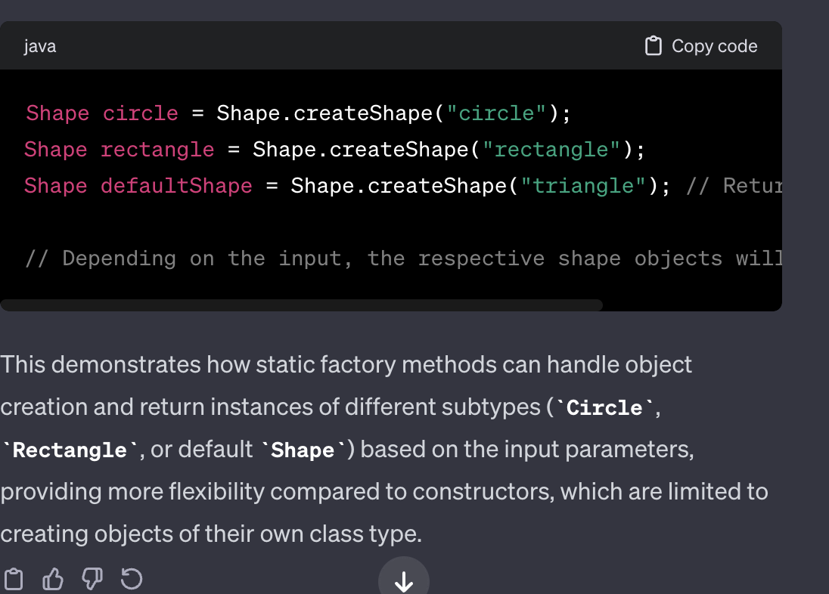
Advantage of static methods
A third advantage of static factory methods is that, unlike constructors,they can return an object of any subtype of their return type.

Slide 5
Advantage of static methods
A fourth advantage of static factories is that the class of the returned object can vary from call to call as a function of the input parameters.
The EnumSet class (Item 36) has no public constructors, only static factories.In the OpenJDK implementation, they return an instance of one of two subclasses,depending on the size of the underlying enum type: if it has sixty-four or fewerelements, as most enum types do, the static factories return a RegularEnumSetinstance, which is backed by a single long; if the enum type has sixty-five or more elements, the factories return a JumboEnumSet instance, backed by a long array.
The existence of these two implementation classes is invisible to clients. If
RegularEnumSet ceased to offer performance advantages for small enum types, it
could be eliminated from a future release with no ill effects. Similarly, a future
release could add a third or fourth implementation of EnumSet if it proved beneficial
CHAPTER 2 CREATING AND DESTROYING OBJECTS 8
for performance. Clients neither know nor care about the class of the object they get
back from the factory; they care only that it is some subclass of EnumSet.

Slide 6
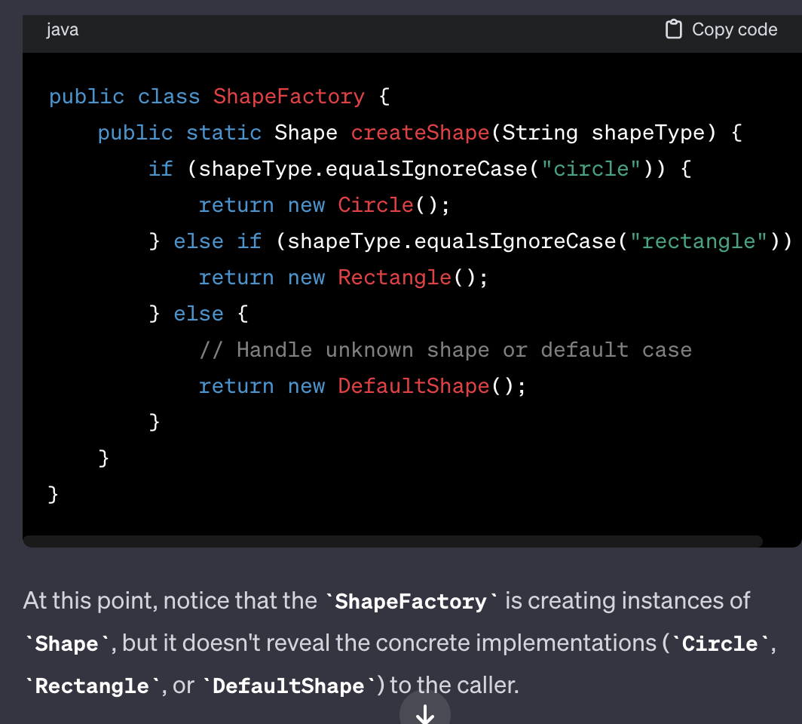
Advantage of static methods
A fifth advantage of static factories is that the class of the returned object
need not exist
when the class
containing the
method is written

Slide 7
Dis-Advantage of static methods
1. Not easy to find them quickly in documentation. Hence we should follow some standards to name them so that we can quickly see them inside a class

Slide 8
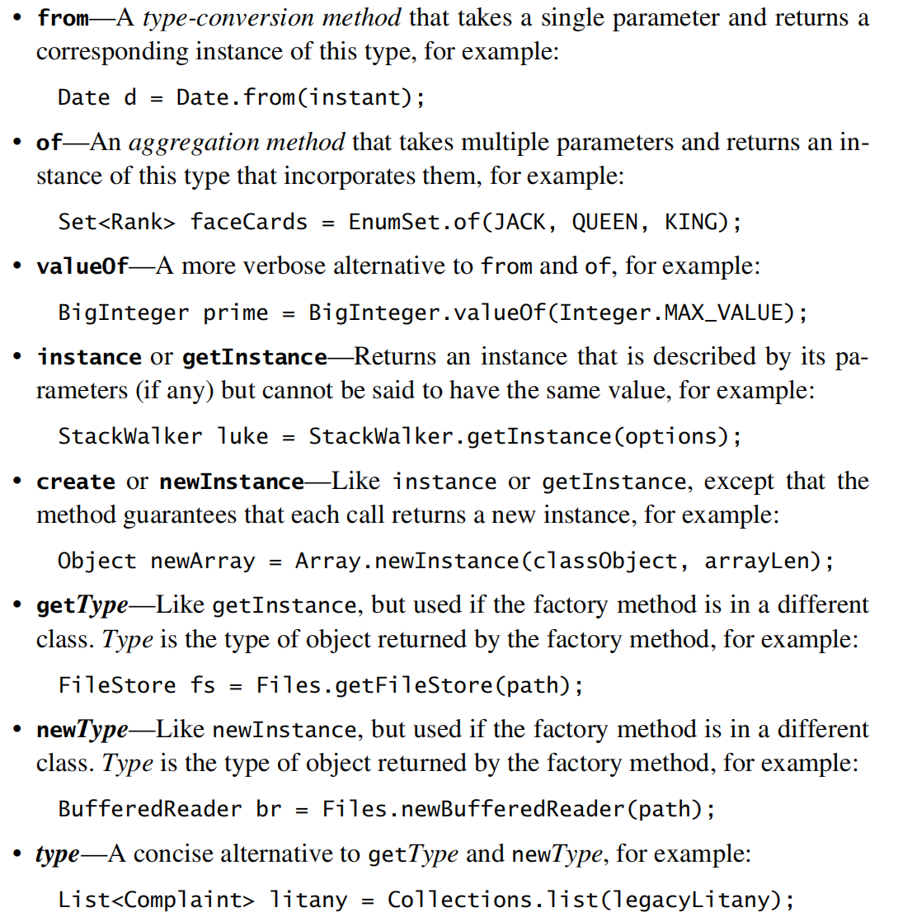

Slide 9
Dis-Advantage of static methods
2nd disadvantage:- if we provide a class with Only static method without public or protected constructors, in such case we will restrict the class to be subclassed .
in one sense this is good because it encourages programmers to use composition instead of inheritance
example
it is impossible to subclass any of the convenience implementation classes in the Collections Framework.

Slide 10
Conclusion
Often static factories are preferable, so avoid the reflex to provide public constructors without first consid_x0002_ering static factories.

